Slide 1


K.RAMAKRISHNAN COLLEGE OF TECHNOLOGY
(AUTONOMOUS), TRICHY
SIMPLE EXPLORATORY DATA ANALYSIS OF COVID-19 DATA USING GGPLOT2
PRESENTED BY
2303811724321065-MITHRAVASAN VBH

Slide 2
PRESENTATION OVERVIEW
Problem Identification
Objective
Proposed system
Block diagram of proposed system
Modules
Module Description
Screenshot
Conclusion and Future Enhancement

Slide 3
PROBLEM IDENTIFICATION
The COVID-19 pandemic has affected global health, economies, and daily life. Analyzing its spread and impact requires Exploratory Data Analysis (EDA).
Key challenges include:
Tracking trends in confirmed cases, recoveries, and fatalities over time.
Understanding regional variations and how different areas were impacted.
Effectively visualizing large datasets for meaningful insights and decision-making.
Handling incomplete and inconsistent data from various sources.

Slide 4
OBJECTIVE
The aim of this study is to perform Exploratory Data Analysis (EDA) on COVID-19 datasets using ggplot2 in R to:
Analyze trends in confirmed cases, recoveries, and fatalities over time.
Understand regional variations in COVID-19 spread and impact.
Identify correlations between different factors such as infection rates, recovery rates, and mortality rates.
Visualize key insights using line charts, bar plots, scatter plots, and heatmaps.
Handle missing and inconsistent data for accurate analysis.
Improve decision-making by presenting clear, data-driven insights to policymakers and researchers.

Slide 5
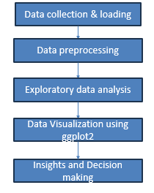
PROPOSED SYSTEM
BLOCK DIAGRAM

Slide 6
PROPOSED SYSTEM
Data Collection & Loading Source COVID-19 data (e.g., from WHO, JHU, or public datasets) and load it into R using packages like readr or read.csv.
Data Preprocessing Clean the dataset by handling missing values, standardizing date formats, and filtering for relevant regions or time periods.
Exploratory Data Analysis (EDA) Summarize key metrics (e.g., total cases, deaths, recoveries) and identify trends, outliers, or anomalies in the data.
Data Visualization Using ggplot2 Create visualizations like time series plots, bar charts, or scatter plots to explore trends in COVID-19 cases, deaths, or vaccination rates.
Insights and Decision Making Extract insights (e.g., peak infection periods, regional impacts) to inform public health strategies or further research.

Slide 7
ADVANTAGES OF PROPOSED SYSTEM
Clear Steps: It follows an easy, organized process—collect data, clean it, explore it, visualize it, and make decisions.
Better Data Quality: Cleaning fixes errors like missing values, making the data more reliable.
Find Patterns Easily: EDA spots trends, like case spikes, to understand the data better.
Great Visuals: ggplot2 creates clear, customizable charts to show trends, making it easy to see what’s happening.
Smarter Choices: Insights from the analysis help make better decisions, like planning healthcare resources.

Slide 8
Module Description
1. Get & Load Data Collect data (e.g., from JHU) and load into R using read.csv. Input: CSV file (dates, countries, cases, deaths). Output: Loaded data.
2. Clean the Data Fix dates, remove missing data, and filter (e.g., India) using dplyr. Input: Loaded data. Output: Clean data.
3. Explore the Data Calculate totals (cases, deaths) and daily new cases with dplyr. Spot trends. Input: Clean data. Output: Trends and numbers.
4. Make Charts with ggplot2 Create line charts (daily cases) and dot charts (cases vs. deaths). Input: Trends. Output: Visual charts.
5. Find Insights & Decide Identify peaks and patterns. Suggest actions (e.g., resource planning). Input: Charts. Output: Useful ideas.
Notes:
8

Slide 9
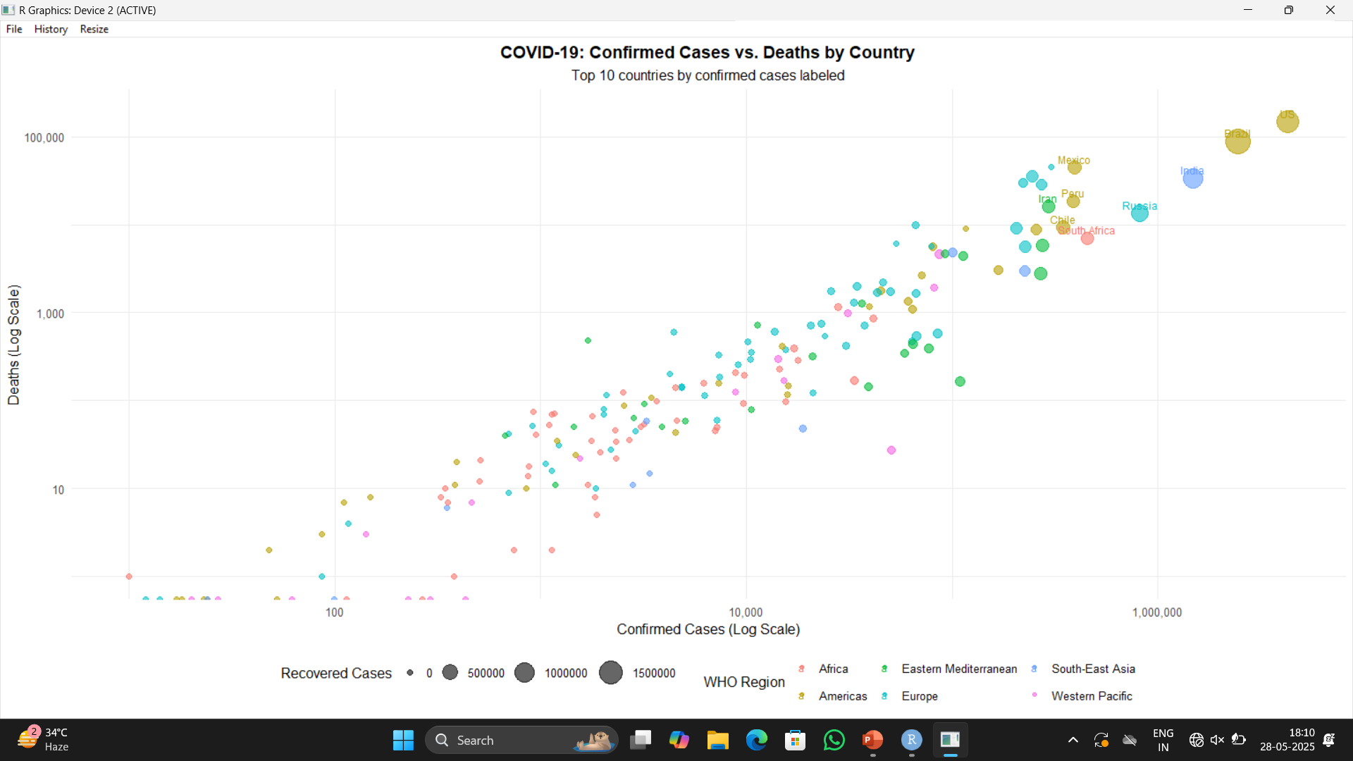
Screenshot
Notes:
9

Slide 10
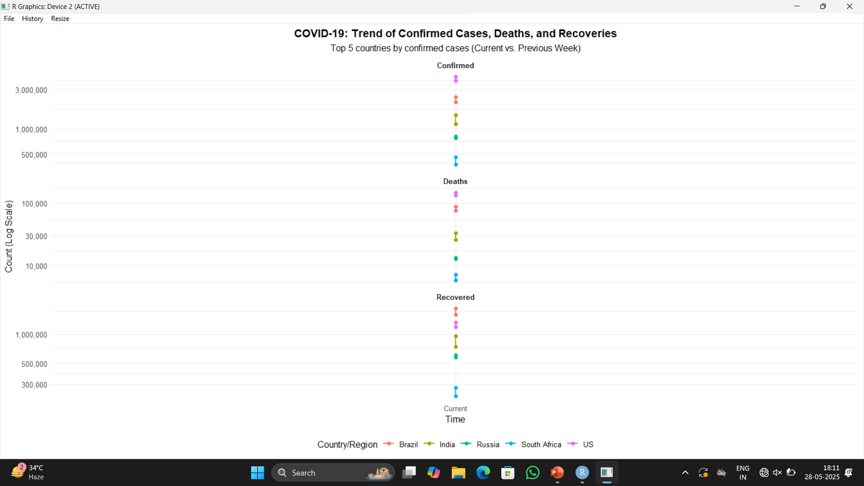
Screenshot
Notes:
10

Slide 11
Conclusion and Future Enhancement
In this project, we used ggplot2 in R to explore COVID-19 data. We created simple graphs to understand how the virus spread in different countries over time. The visualizations helped us see patterns in the number of cases, recoveries, and deaths. This basic analysis gave us a clear picture of the pandemic using easy-to-read charts.
Future Enhancement
Add Interactive Charts – Use tools like shiny or plotly to make the graphs clickable and easier to explore.
Use Live Data – Connect to live COVID-19 updates for real-time analysis.
Predict Trends – Use simple prediction methods to guess future case numbers.
Show Data on Maps – Add maps to see which areas are most affected.
Clean Data Better – Make data cleaning faster and automatic.
Include Vaccination Info – Compare data with vaccination records for more insights.
Notes:
11

Slide 12
THANK YOU

